Slide 1
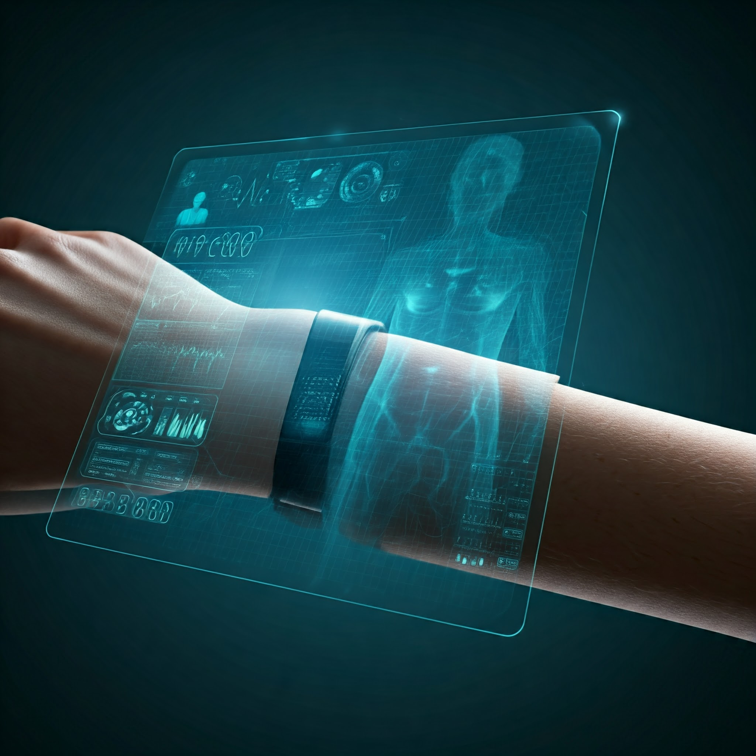
Team Name
Team ID: CtrlAltDefeat
Members
Name: Yugansh Kumar
Name: Swastik Swarup Dash
Name: Saharsh Pandey
College
College Name: Kalinga Institute of Industrial Technology (KIIT)
Location: Bhubaneswar, Odisha

Slide 2
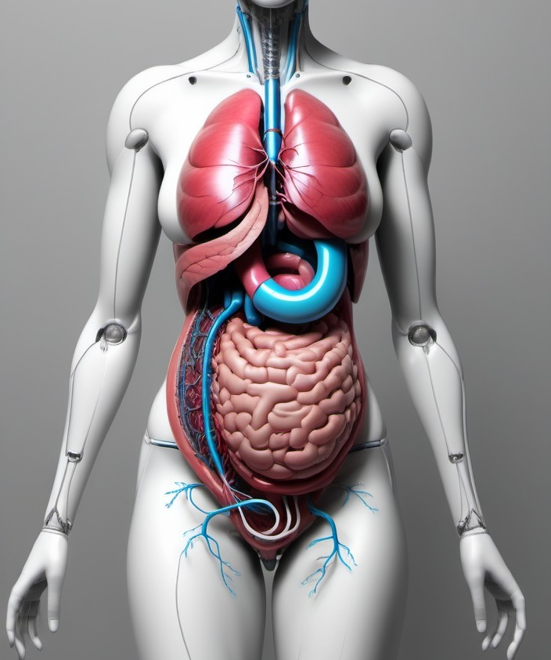
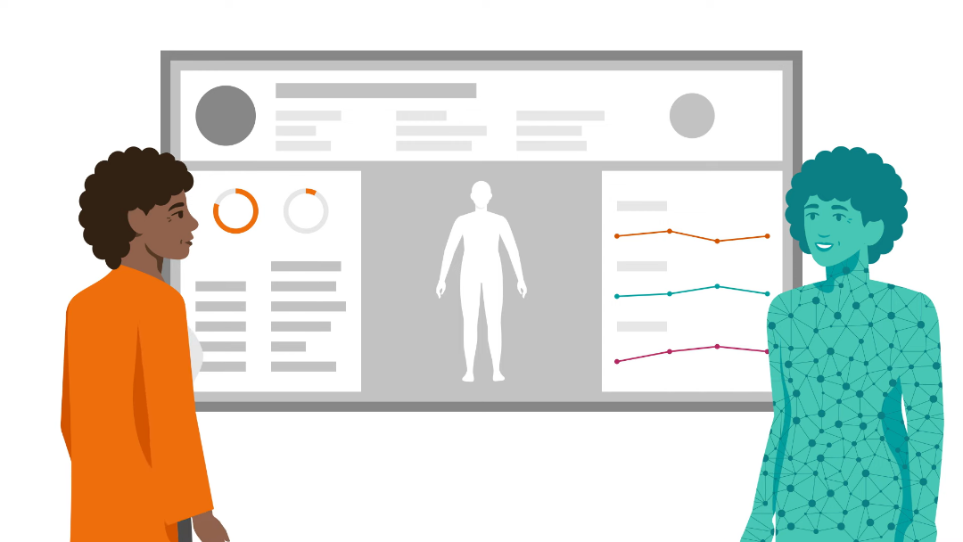
Summary: Body Link(Digital Twin of Human Body)
In healthcare, several key issues persist which can be solved via Digital Twin Technology some of the Issues are as Mentioned:
Personalized Care Gaps: Treatments often aren't tailored to individual needs, leading to ineffective results.
Delayed Diagnosis: Many conditions are identified too late, worsening outcomes.
Overburdened Systems: Healthcare providers face capacity issues, especially in emergencies.
High Costs: Ineffective treatments and prolonged hospital stays increase expenses.
Chronic Disease Management: Continuous monitoring for chronic conditions is inefficient.
Limited Patient Availability: Many patients miss medical appointments or delay seeking care due to busy schedules, resulting in untreated conditions and worsening health outcomes.

Slide 3
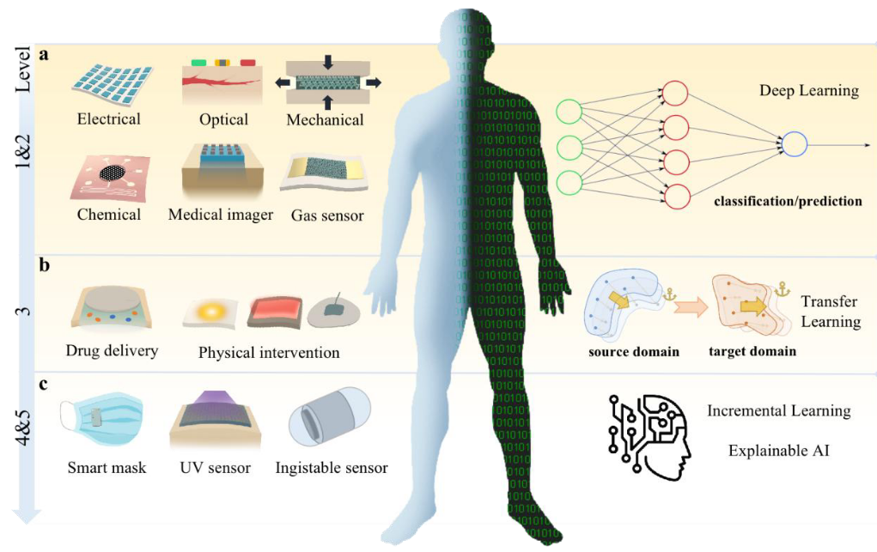
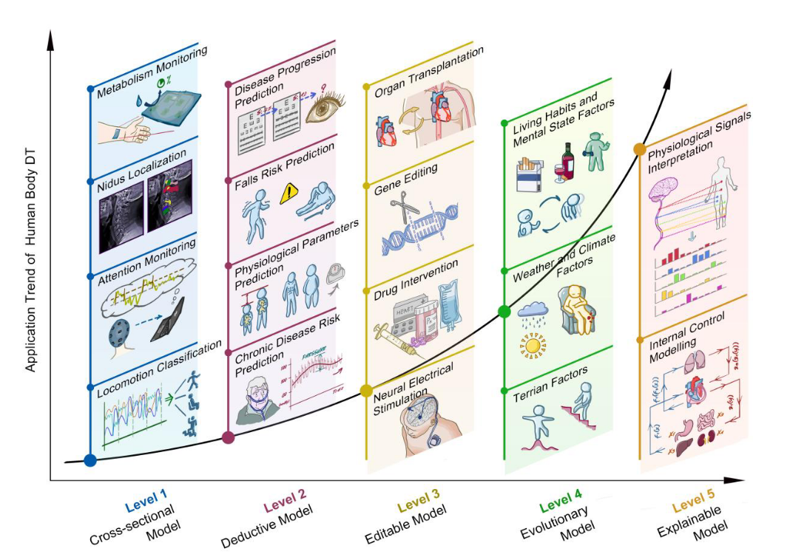
Solution:
The study addresses the problem of providing a continuous, non-invasive, and cost-effective method for monitoring individuals' health status. This is particularly beneficial in preventive healthcare and personalized medicine. By integrating basic and advanced medical grade sensors into a wearable device with App Support, the collected data like Heart Rate, EMG, ECG, SpO2, Heart-Rate, Blood Glucose Level, Temperature, Stress Level, Physical Activity Levels, Electrolyte balance, hydration levels etc. can be continuously analyzed to detect early signs of health issues using AI, Deep Learning and IoT.
As for accessibility, the data collected can be shared with doctors and biomedical engineers remotely in App when required it can be either automatic when any anomaly is detected in the data of Digital Twin or when the user personally feels ill. This allows for analysis and treatment recommendations without the need for physical visits, saving time and making healthcare more efficient.
In conclusion, the study demonstrates that a digital twin of the human body using basic sensors can provide valuable insights into an individual’s health, enabling proactive healthcare measures. This approach offers a promising tool for enhancing health monitoring, allowing for timely interventions, and potentially improving overall health outcomes through continuous and personalized health assessment.

